Slide 1

Lifestyle Store Web Application
Detailed Developer Report

Slide 2
Security Status – Extremely Vulnerable
Hacker can steal all records in Internshal databases (SQLi)
Hacker can take control of complete server including View, Add, Edit, Delete files and folders (Shell Upload)
Hacker can change source code of application to host malware, phishing pages or even explicit content (Shell Upload)
Hacker can inject client side code into applications and trick users by changing how page looks to steal information or spoil the name of Internshala (XSS)
Hacker can extract mobile number of all customers using Userid (IDOR)

Slide 3
Vulnerability Statistics
Critical
10
Severe
7
Moderate
4
Low
4

Slide 4
Vulnerabilities:
No | Severity | Vulnerability | Count
1 | Critical | SQL Injection | 1
2 | Critical | Access to sales dashboard | 1
3 | Critical | Access to admin panel | 2
4 | Critical | Account takeover via OTP Bypass | 1
5 | Critical | Unauthorized Access To Customer Details | 1
6 | Severe | Cross site scripting | 2
7 | Moderate | Directory Listing of Configuration Files | 3
8 | Low | Information disclosure due to Apache Default Pages | 3

Slide 5
1. SQL Injection
SQL Injection (Critical) | Below mentioned URL in the Product Search Page is vulnerable to SQL injection attack Affected URL : http://13.127.11.167/search/search.php?q=blue Affected Parameters : q (GET parameter) Payload: q=blue’

Slide 6
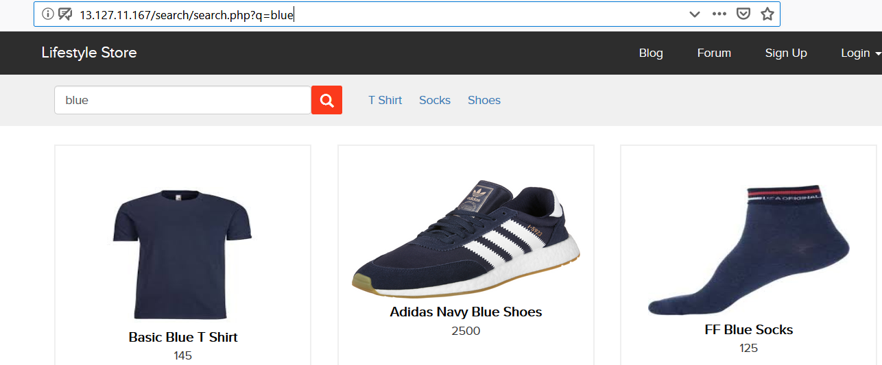
Observation
Navigate to products page where you will see search field.Enter a search query. Notice the GET parameter house in the URL:

Slide 7
Observation
We apply single quote in q parameter: q=blue’ and we get complete MySQL error:

Slide 8
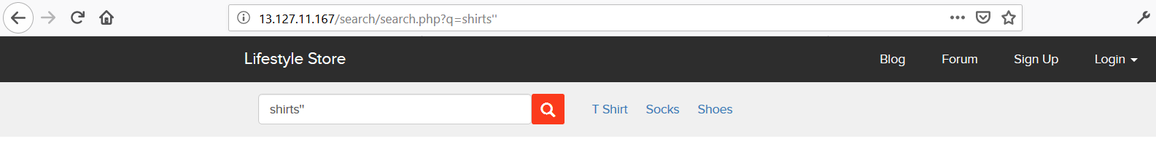
Observation
We then put “ : q=blue” and the error is removed confirming SQL injection:

Slide 9
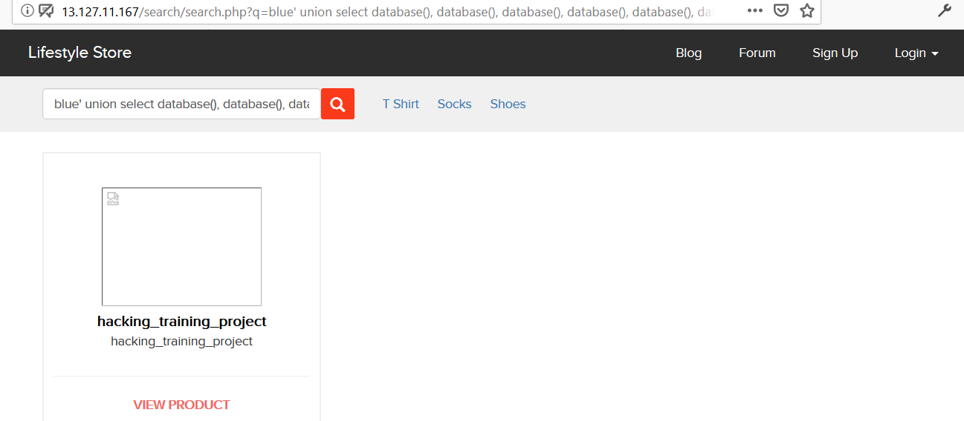
Proof of Concept (PoC)
Attacker can execute SQL commands as shown below. Here we have used the payload below to extract the database name and MySQL version information: q=blue’ union select database(), database(), database(), database(), database(), database(), database()--+

Slide 10
PoC – Attacker can dump arbitrary data
No of databases: 2
Information_schema
Hacking_training_project

Slide 11
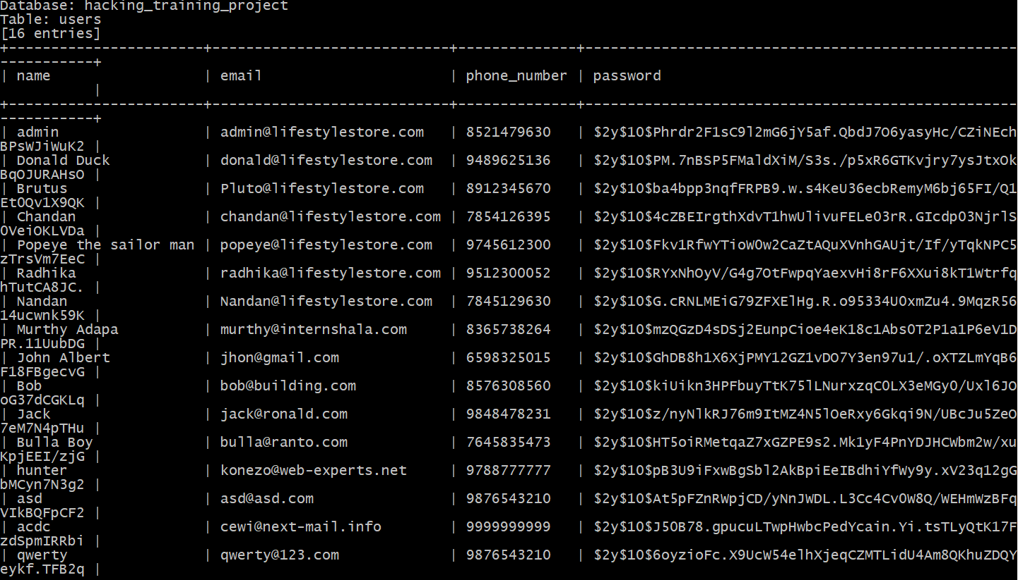
Business Impact – Extremely High
Using this vulnerability, attacker can execute arbitrary SQL commands on Internshala server and gain complete access to internal databases along with all customer data inside it.
Below is the screenshot of users table which shows user credentials being leaked that too in plain text without any hashing/encryption.
Attacker can use this information to login to admin panels and gain complete admin level access to the website which could lead to complete compromise of the server and all other servers connected to it.

Slide 12
Recommendation
Take the following precautions to avoid exploitation of SQL injections:
Whitelist User Input: Whitelist all user input for expected data only. For example if you are expecting a flower name, limit it to alphabets only upto 20 characters in length. If you are expecting some ID, restrict it to numbers only
Prepared Statements: Use SQL prepared statements available in all web development languages and frameworks to avoid attacker being able to modify SQL query
Character encoding: If you are taking input that requires you to accept special characters, encode it. Example. Convert all ‘ to \’ , “ to \”, \ to \\. It is also suggested to follow a standard encoding for all special characters such has HTML encoding, URL encoding etc
Do not store passwords in plain text. Convert them to hashes using SHA1 SHA256 Blowfish etc
Do not run Database Service as admin/root user
Disable/remove default accounts, passwords and databases
Assign each Database user only the required permissions and not all permissions

Slide 13
References
https://www.owasp.org/index.php/SQL_Injection
https://en.wikipedia.org/wiki/SQL_injection

Slide 14
2. Access to Sales Dashboard
Access to Sales Dashboard (Critical) | The Sales dashboard at the below mentioned URL has default/weak password allowing complete admin access Affected URL : http://13.127.11.167/wondercms/loginURL Affected Parameters : password (POST parameters) Payload: Username=admin password=admin

Slide 15
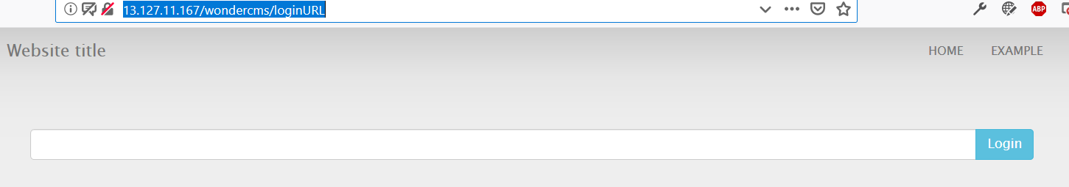
Observation
Navigate to http://13.127.11.167/wondercms/loginURL You will see sales admin login page

Slide 16
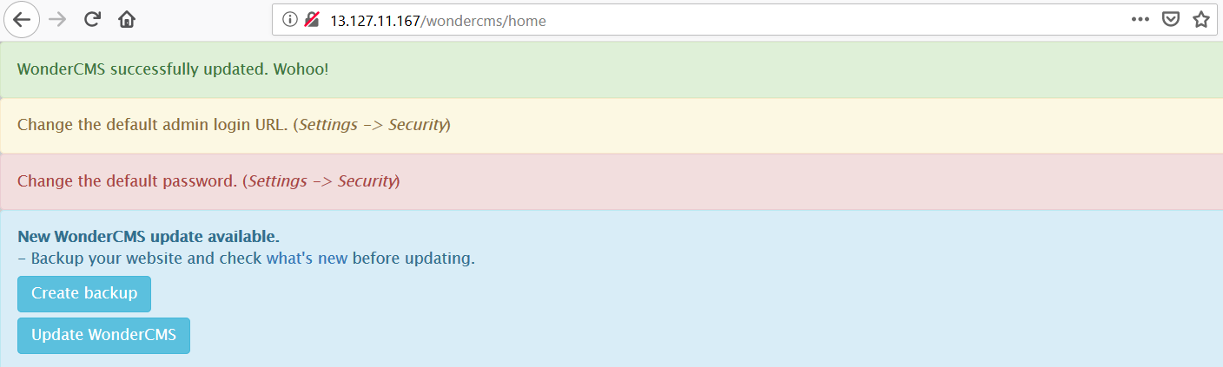
Observation
Enter username: admin & password: admin. You will get loggedin to the admin panel

Slide 17
Business Impact – Extremely High
A malicious user can access the Sales Dashboard which discloses many critical
information of organization including:
Sales Trends
Client information
Leads information
Sales Calandar information
Income and revenue information
And much more…

Slide 18
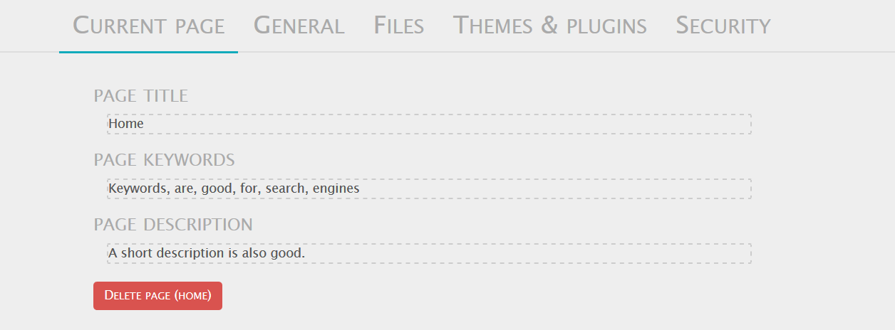
POC

Slide 19
Recommendation
Take the following precautions:
Use a strong password 8 character or more in length with alphanumerics and symbols
It should not contain personal/guessable information
Do not reuse passwords
Disable default accounts and users
Change all passwords to strong unique passwords
References:
https://www.owasp.org/index.php/Testing_for_weak_password_change_or_reset_functionalities_(OTG-AUTHN-009)
https://www.owasp.org/index.php/Default_Passwords
https://www.us-cert.gov/ncas/alerts/TA13-175A

Slide 20
THANK YOU
For any further clarifications/patch assistance, please
contact: XXXXXXX

